Slide 1

Presented by,
Niyaz Ahmed

Slide 2
What is Big Data?
Big data usually includes data sets with sizes beyond the ability of commonly used software tools to capture, curate, manage, and process data within a tolerable elapsed time. Big data "size" is a constantly moving target.

Slide 3
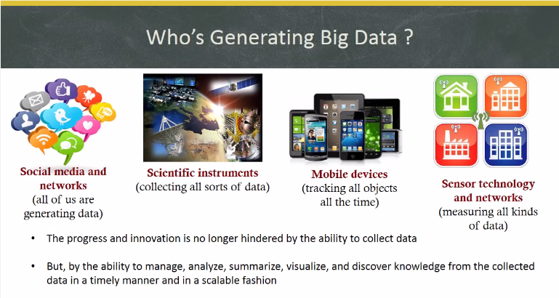

Slide 4
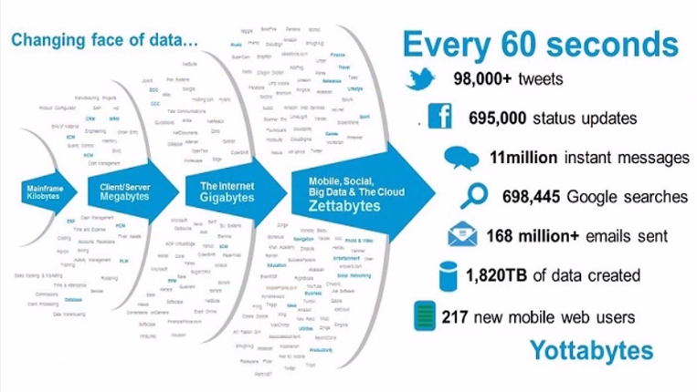

Slide 5
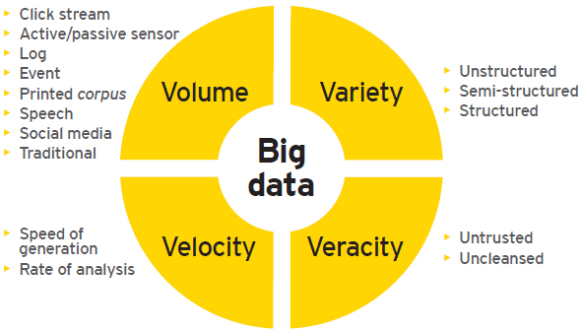

Slide 6
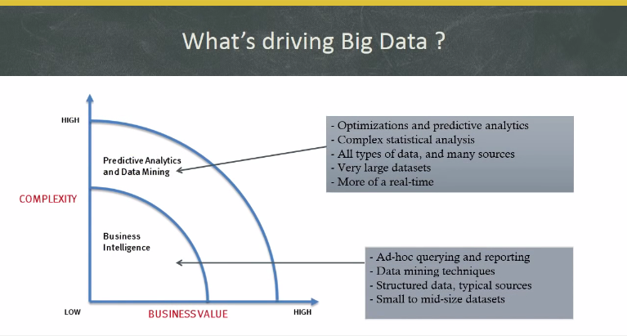

Slide 7


Slide 8
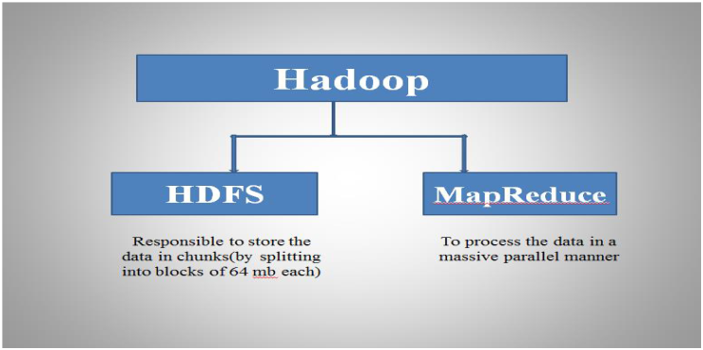

Slide 9
Features of Hadoop
Cost Effective System
Parallel Processing
Scalability
Distributed Data
Automatic Failover Management

Slide 10
Java Prerequisite
OOPS Concept
Variables, Data Types
Loops and Condition
Function and Object Creation
Exceptions Handling
Java Collections and Generics
Basic SQL Queries
NoSQL

Slide 11
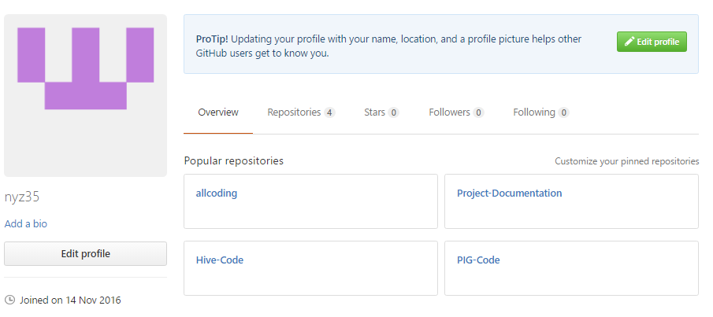
GITHUB Maintenance

Slide 12
Extra Study Links
BLOCK SIZE AND REPLICATION - http://princetonits.com/blog/technology/how-to-configure-replication-factor-and-block-size-for-hdfs/
HADOOP ARCHITECTURE - http://ercoppa.github.io/HadoopInternals/HadoopArchitectureOverview.html
HIVE Vs PIG - https://www.dezyre.com/article/difference-between-pig-and-hive-the-two-key-components-of-hadoop-ecosystem/79
JOINS VIDEO - https://www.youtube.com/watch?v=WUC59r1tT_4
MAP SIDE AND REDUCE SIDE JOINS - https://www.bigdatapartnership.com/2012/02/29/map-side-and-reduce-side-joins/

